Slide 1
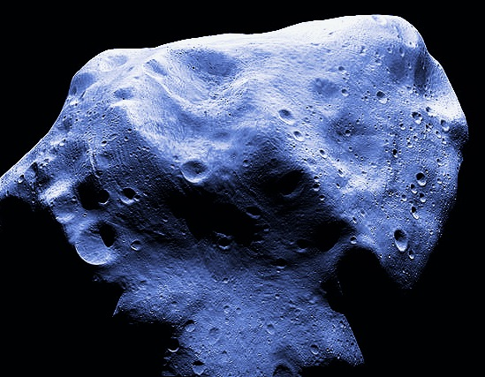
Starwahl
NE Asteroid Mining
NEO 2000 SG 344
Mass 7.1x 10^7
Diameter 37 meter
Class Unknown Suspected C
Total Mission delta-V (km/s) 5.973
Total Mission Duration (d) 1008 Outbound Flight Time (d) 356 Inbound Flight Time (d) 712
Launch date (YYYY-MM-DD) 2024-04-22
C₃ (km²/s²) 1.737 3.009
Departure V_{infinity} (km/s) 1.318 Earth Departure dV (km/s) 3.256
dV to Arrive at NEA (km/s) 0.113
dV to Depart NEA (km/s) 0.187 Earth return dV (km/s) Varible
Entry Speed (km/s) 11.133
Depature Declination (deg) -8.950 Return Declination (deg) -5.933
NHATS Trajectory Solution ID 890465
NASA Space Apps Challenge
4/24/2016

Slide 2
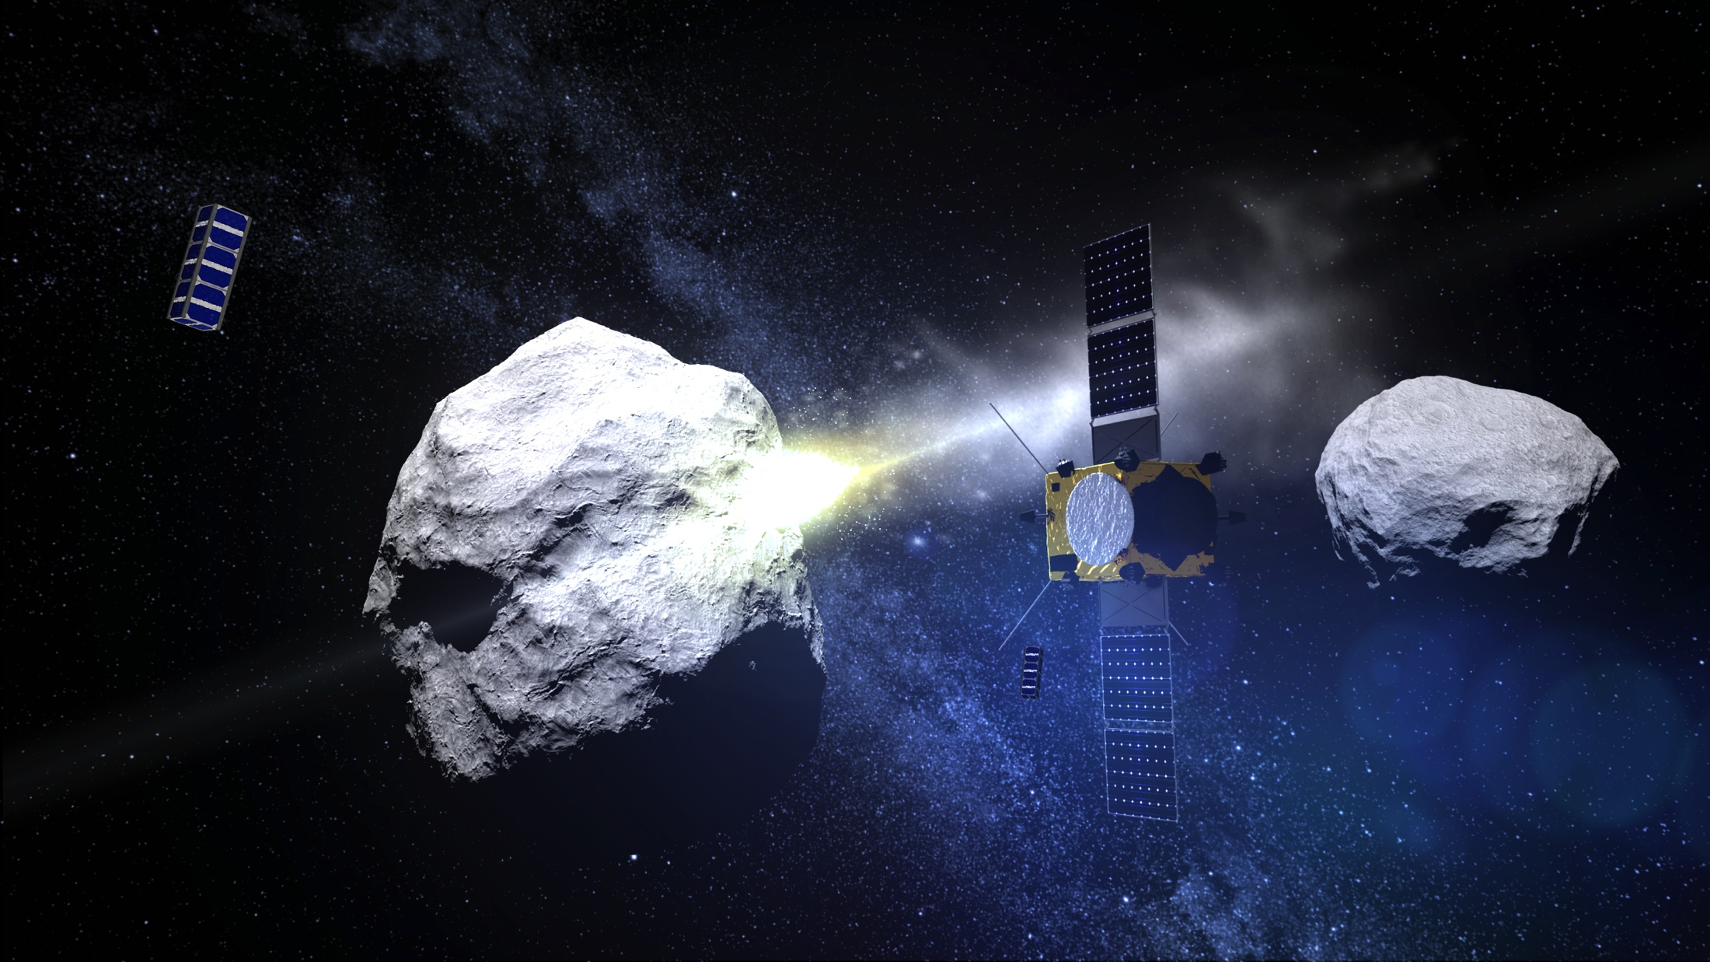
Mother ship

Slide 3
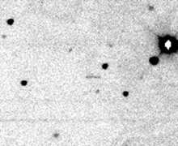
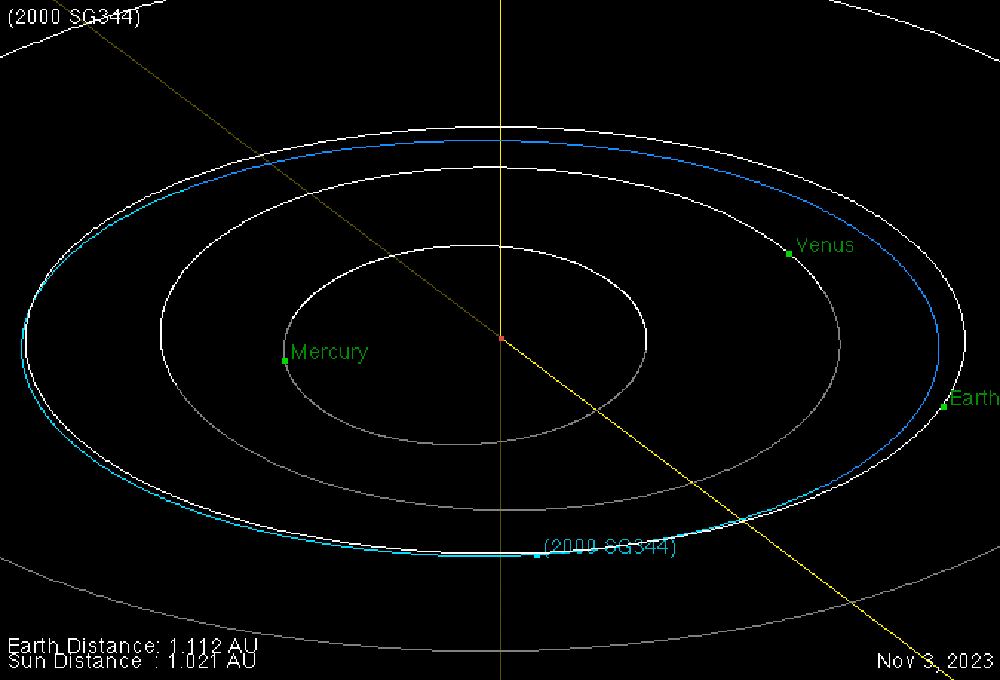
Orbit, transit
2000 SG 344

Slide 4
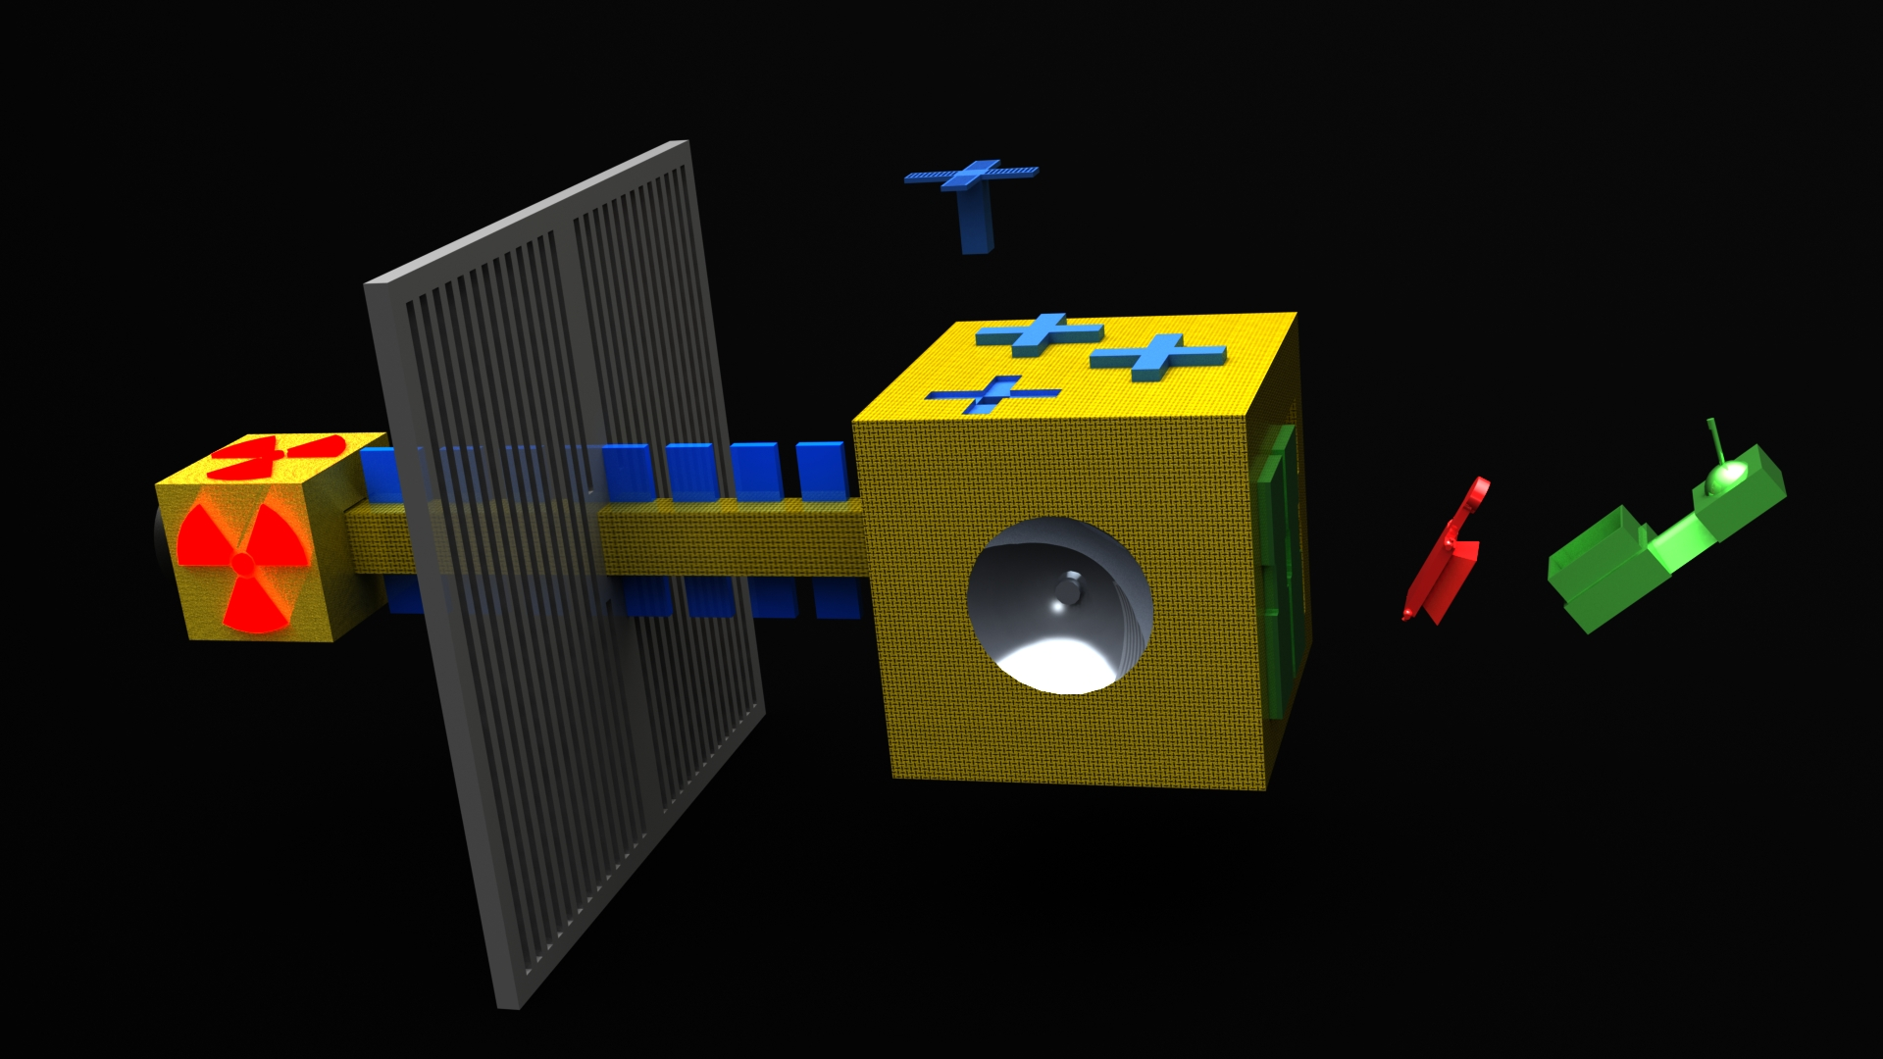
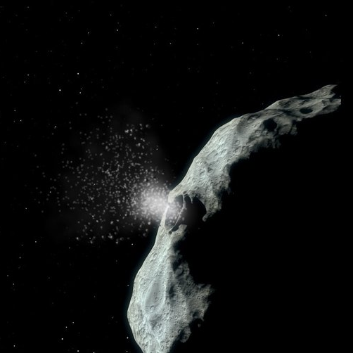
Impactor / Drones

Slide 5
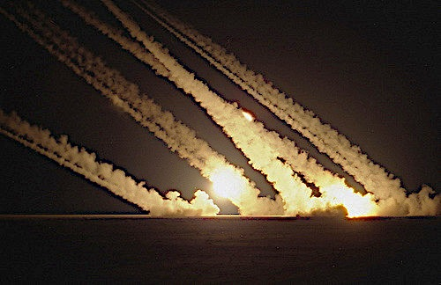
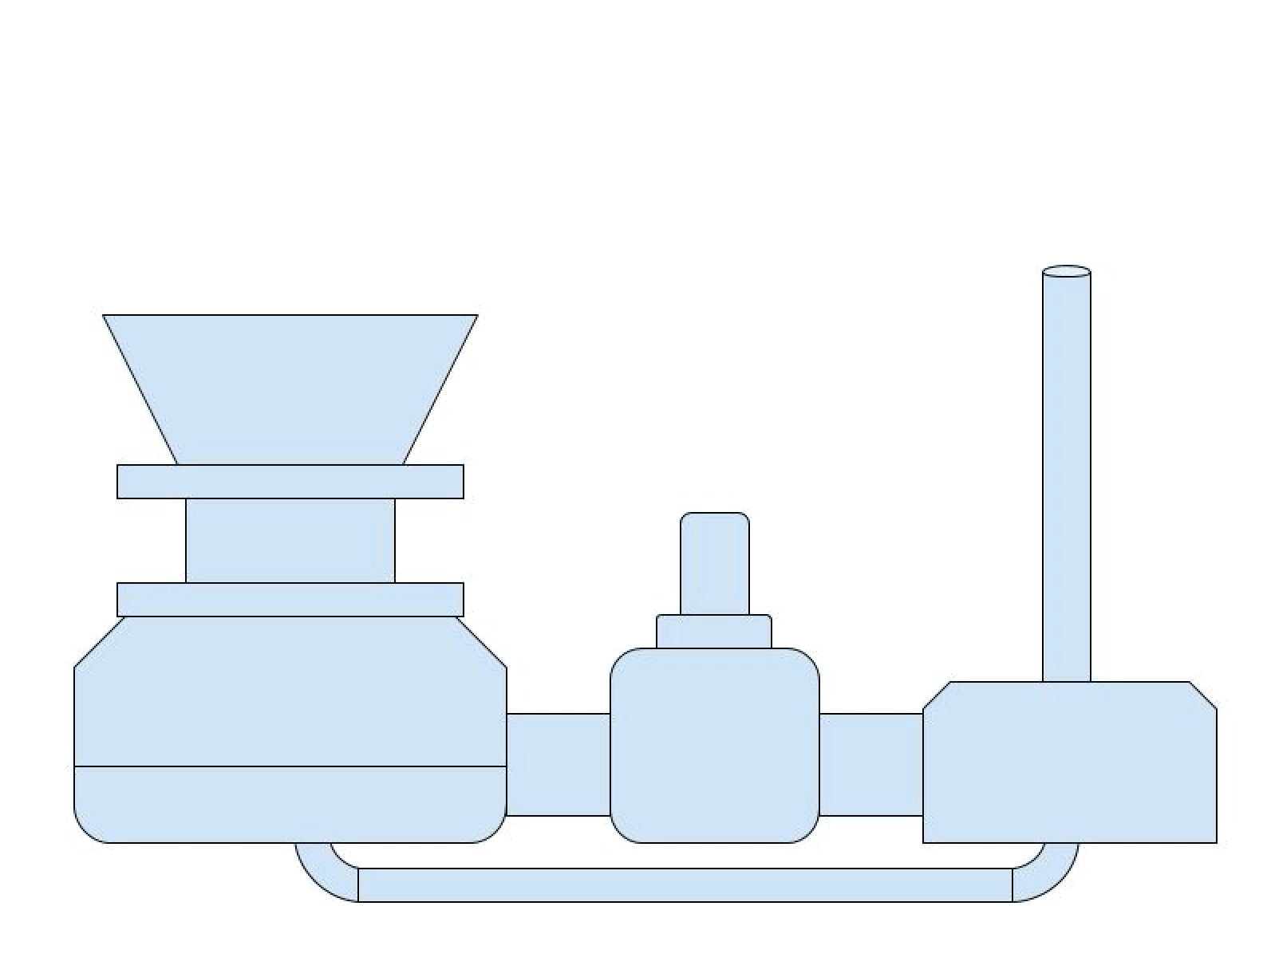
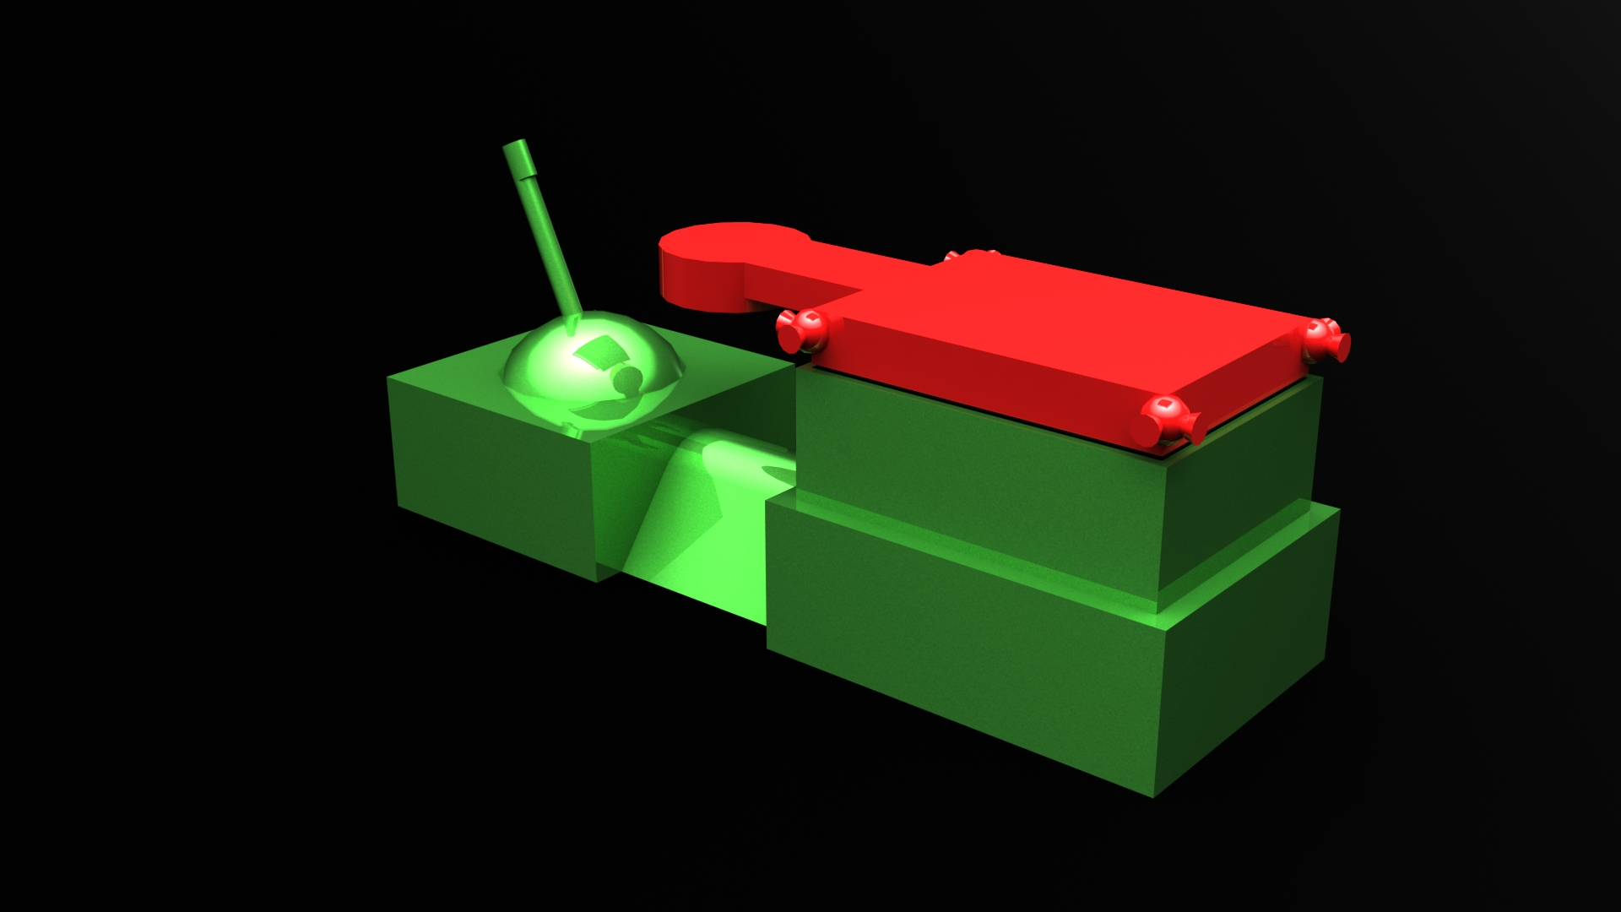
Mass Launcher Drive

Slide 6
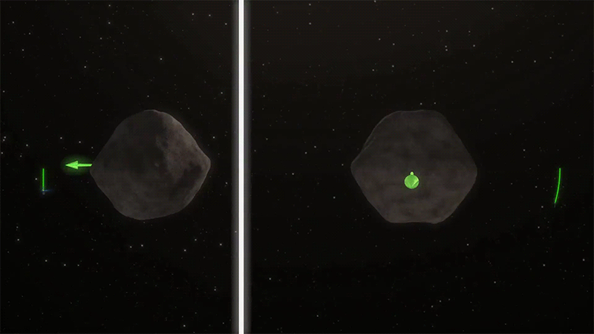

Gravity Tractor
Not a John Deer

Slide 7
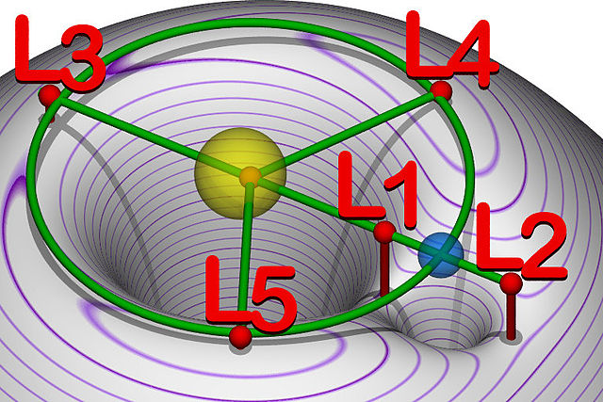
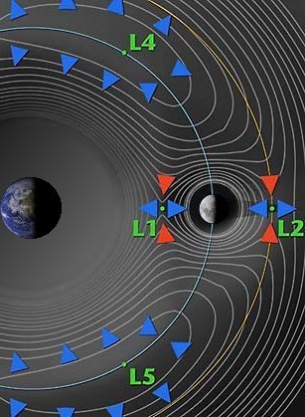
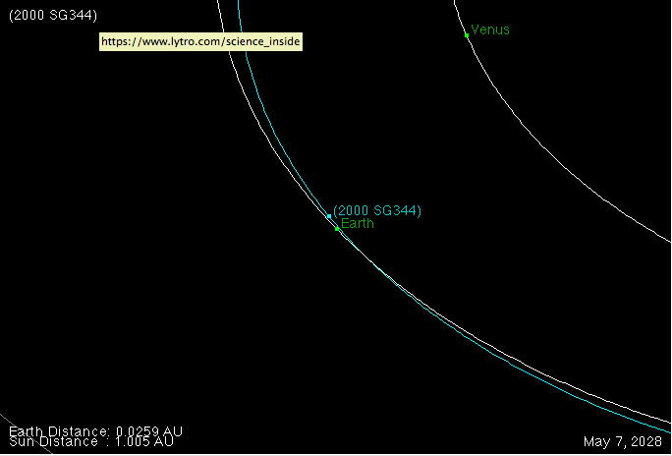
Return to L1
Closest approach May 7, 2028
Distance from Earth .0259 AU

Slide 8
Research and resources
http://www.nasa.gov/content/asteroid-redirect-mission-planetary-defense-demonstration
http://creativecommons.org/licenses/by-sa/3.0/
http://wildernessastronomy.com/wp-content/uploads/2012/05/asteroid_21_lutetia_nasa_observing_binoculars.jpg
http://neo.jpl.nasa.gov/cgi-bin/nhats
http://neo.jpl.nasa.gov/cgi-bin/nhats?sstr=2000%20SG344&dv=6&dur=360&stay=8&launch=2015-2040
http://neo.jpl.nasa.gov/risk/2000sg344.html
http://neo.jpl.nasa.gov/stats/wise/
http://www.space.com/30213-asteroid-mining-planetary-resources-2025.html#sthash.Ez1nmiYz.dpuf
EASILY RETRIEVABLE OBJECTS AMONG THE NEO POPULATION D. García Yárnoz,* J. P. Sánchez,† and C. R. McInnes† DOI: 10.1007/s10569-013-9495-6. Pre-print proof-reading copy. The final publication is available at: http://link.springer.com/article/10.1007/s10569-013-9495-6 Celest Mech Dyn Astr (2013) 116:367–388
http://www.nasa.gov/content/goddard/new-nasa-mission-to-help-us-learn-how-to-mine-asteroids/
https://www.youtube.com/watch?v=0KUdyBm6bcY
WRANGLER: Capture and De-Spin of Asteroids and Space Debris http://www.nasa.gov/content/wrangler-capture-and-de-spin-of-asteroids-and-space-debris/#.Vxy8iKvUCAZ
Resource Prospector
https://www.nasa.gov/resource-prospector/
Glass Beads, Meteorite Fragments Hold Secret to Working on Asteroids
http://www.nasa.gov/feature/glass-beads-meteorite-fragments-hold-secret-to-working-on-asteroids
Microwave assisted hard rock cutting
US 5003144 A
12 August 2015 Forget fracking, microwave zaps could clean up the oil business
https://www.newscientist.com/article/mg22730340-400-forget-fracking-microwave-zaps-could-clean-up-the-oil-business/
Tuesday, April 29, 2008Microwave rock drill
https://www.newscientist.com/blog/invention/2008/04/microwave-rock-drill.html
June 4, 2014
Technologies for Asteroid Capture into Earth Orbit
by Stephen D. Covey International Space Development Conference, May 2011
http://www.esa.int/var/esa/storage/images/esa_multimedia/images/2015/02/asteroid_impact/15264255-1-eng-GB/Asteroid_impact_node_full_image_2.jpg

Slide 9
STARWAHL
Near Earth Asteroid Mining
Ilya Malinskiy
Rob Groth
Brian S. Stofiel
Joel Byler
William Wilson
Mike Peabody
Thanks to the Dragonfly team, NASA Glenn and all the Space App Challenge staff and participants

